Slide 1
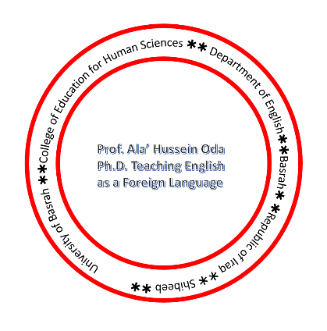
Teaching Methods
chronology

Slide 2
Advantages and Disadvantages

Slide 3
The Grammar-Translation Method

Slide 4
Latin and Greek

Slide 5
Procedure
Literary texts
Highly rhetorical
Grammar rules( in detail)
Bilingual list
Memorization
Translation
Evaluation of translation

Slide 6
Over all Evaluation
Dead Language
No communication
Skills neglected
Boring

